Slide 1
Cell Behaviour Modeling Platform
Ryan Carey, Lewis Kindeleit, Antoine Messager

Slide 2
Design aims
Flexibly & efficiently
reproduce biologically realistic behaviour
Graphical or prompt
Graphical or binary
2

Slide 3
Design choices
Agent-based models
3

Slide 4
Agent-based models (ABMs)
Suited to modelling interdependent modules (e.g. cells)
Flexible
Can model heterogenous entities with heterogenous interaction network. (Kaul 2015)
Growing in popularity with increasing computing power
4

Slide 5

Design choices
Agent-based models
Continuous space
Different types of cells
Environment modelled with PDEs
Julia Language
5

Slide 6
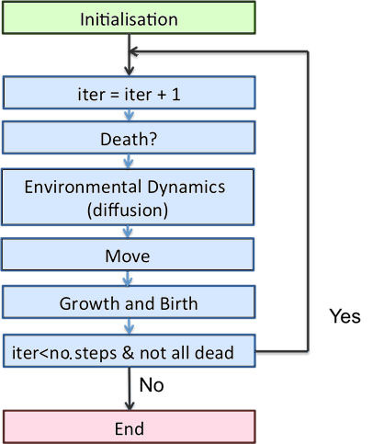
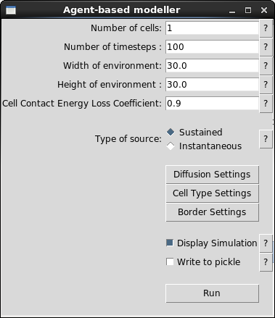
Model overview
6

Slide 7
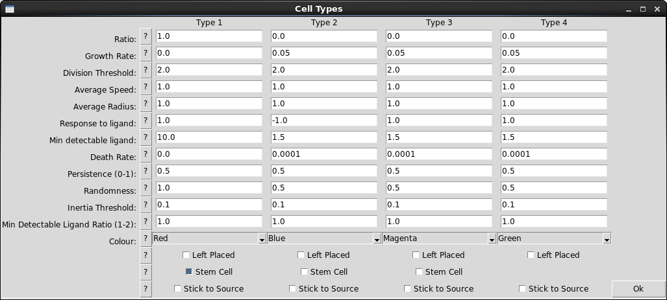
Cell Model Interface
7

Slide 8
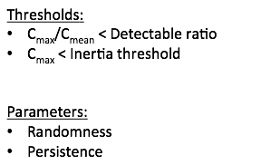
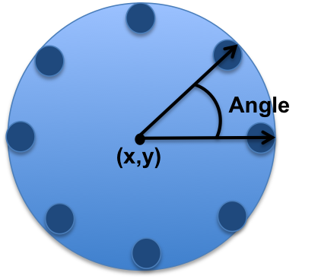
Cell Model
8

Slide 9
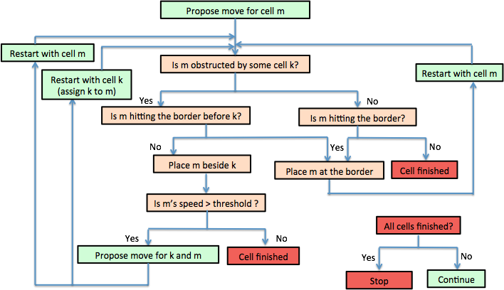
Cell Ballistics
9

Slide 10
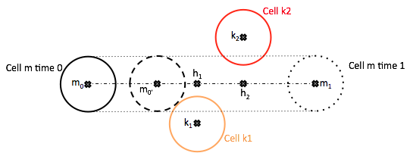
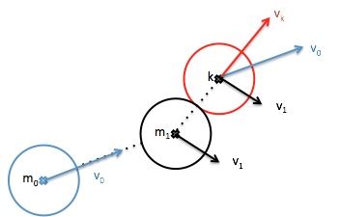
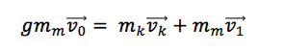
Cell-Cell Interaction
10

Slide 11
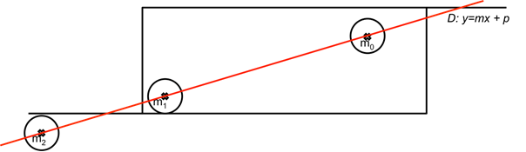
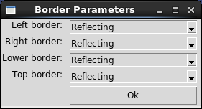
Cell-Wall interaction
11

Slide 12
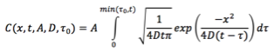
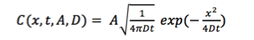
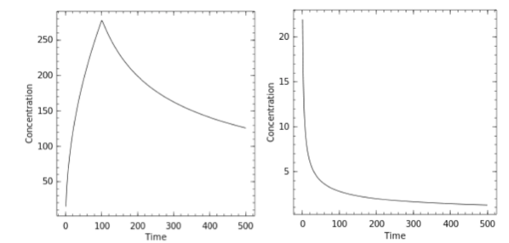
Diffusion
Sustained
Instantaneous
Plot of the concentration of ligands over time at a fixed distance from the source
12

Slide 13
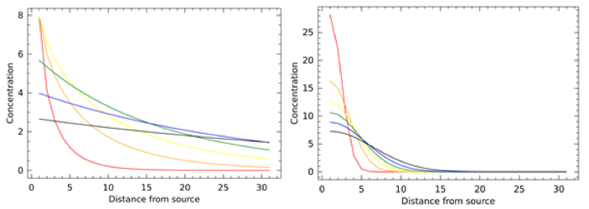
Diffusion Illustration
13

Slide 14
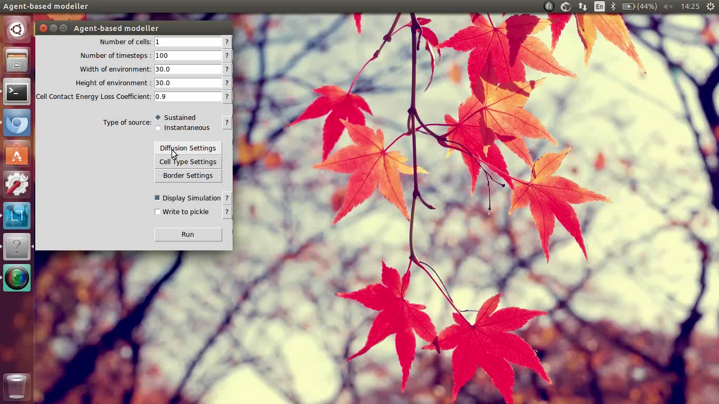
Diffusion Interface
VIDEO of the integrative diffusion instead and click on the location and coefficient button to show the other interface
14

Slide 15
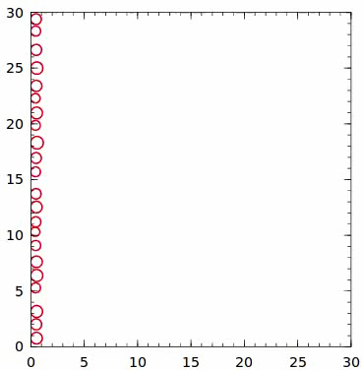
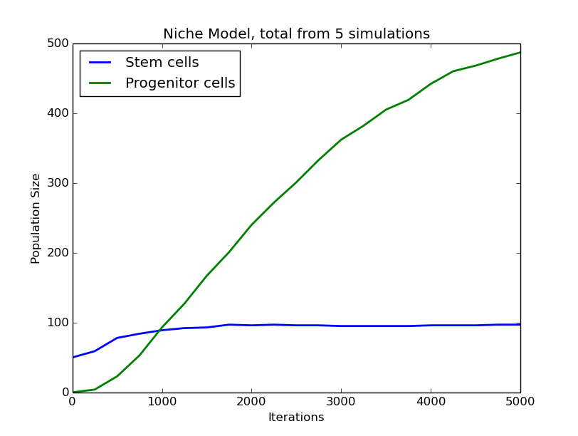
Example: Stem Cell Replication
15

Slide 16
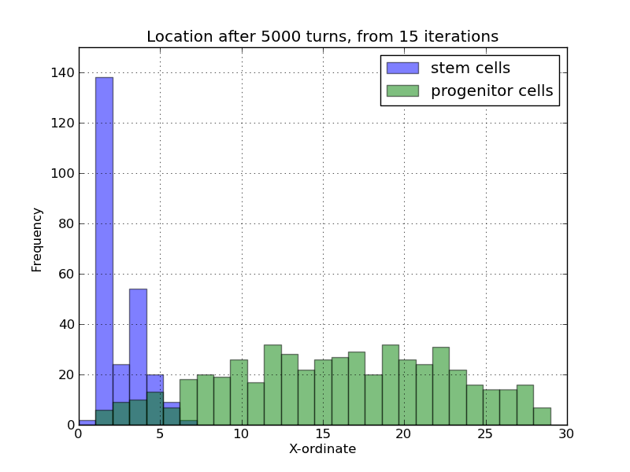
Example: Stem Cell Replication

Slide 17
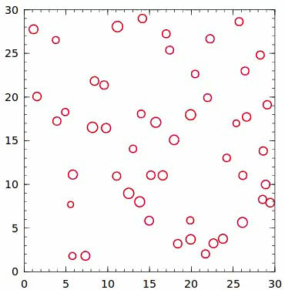
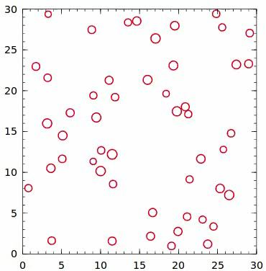
Example: Macrophage Migration

Slide 18
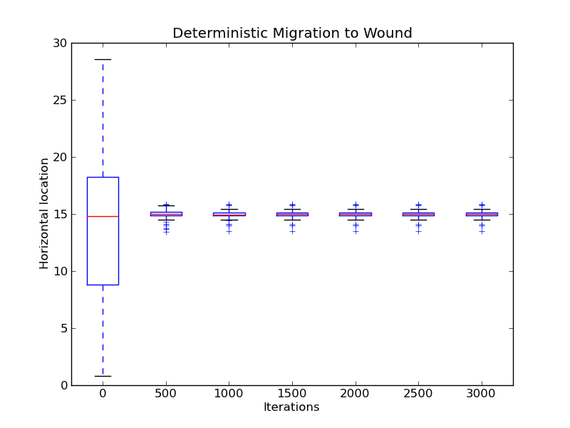
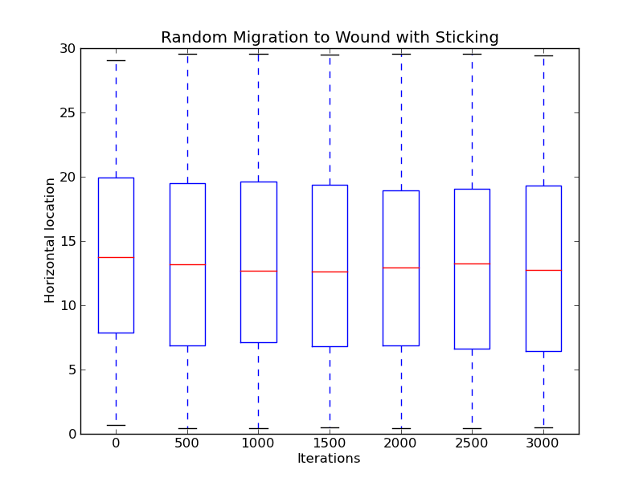
Example: Macrophage Migration

Slide 19
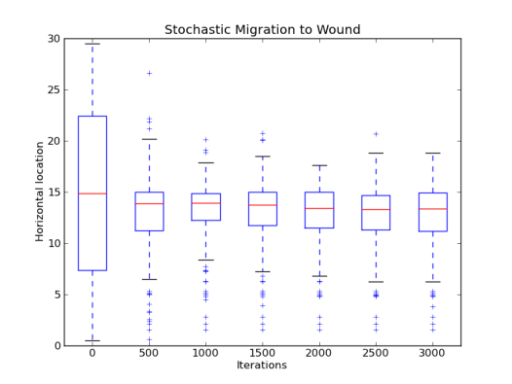
Example: Macrophage Migration

Slide 20
Further Directions
More sophisticated growth and death functions
More than one type of ligand per simulation
Inbuilt parameter inference suite

Slide 21
Conclusions
Design goals reached. Platform flexible and extensible
Can be used for exploratory analysis or data gathering
ABM basis allows for uniqueness

Slide 22
References
Kaul, Himanshu, and Yiannis Ventikos. "Investigating biocomplexity through the agent-based paradigm." Briefings in bioinformatics 16.1 (2015): 137-152.
22

